Slide 1


CHINOOK ARTIST DATABASE management using
Theatre artist

Slide 2
INTRODUCTION :
A database is created to manage theatre artists, plays, acts, and audiences.
Helps track artists, performances, ticket sales, and genres.
Uses SQL queries for analysis.

Slide 3

SQL QUERIES USED :
Basic Retrieval (SELECT, WHERE)
Joins (INNER JOIN, LEFT JOIN)
Aggregation (COUNT, SUM, AVG, HAVING)
Sorting & Filtering (Order by , limit)

Slide 4
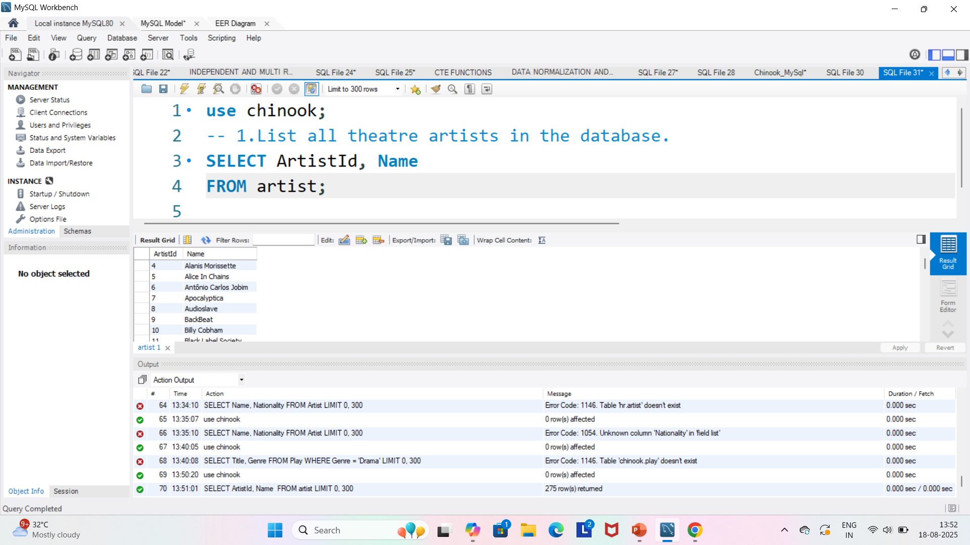
LIST ALL THEATRE ARTIST
This query retrieves the names and IDs of all theatre artists stored in the database.

Slide 5
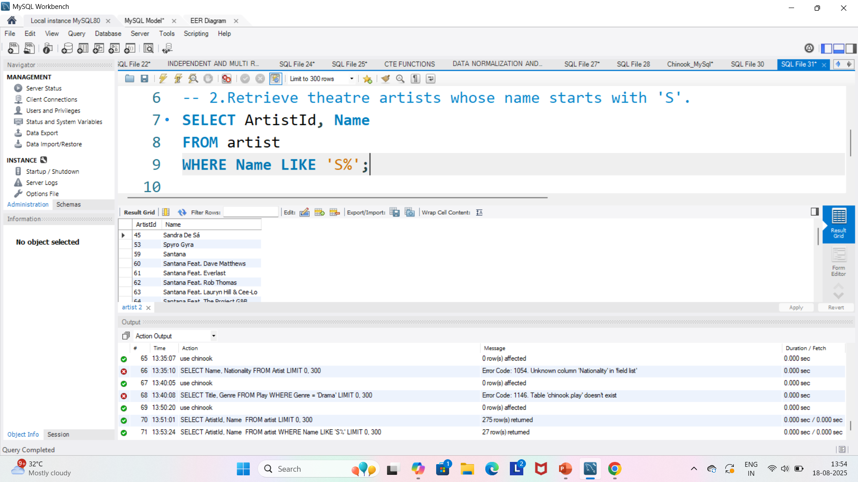
RETRIEVES ARTISTS WHOSE NAME STARTS WITH S
We use the LIKE 'S%' condition to filter artists whose names begin with the letter S.

Slide 6
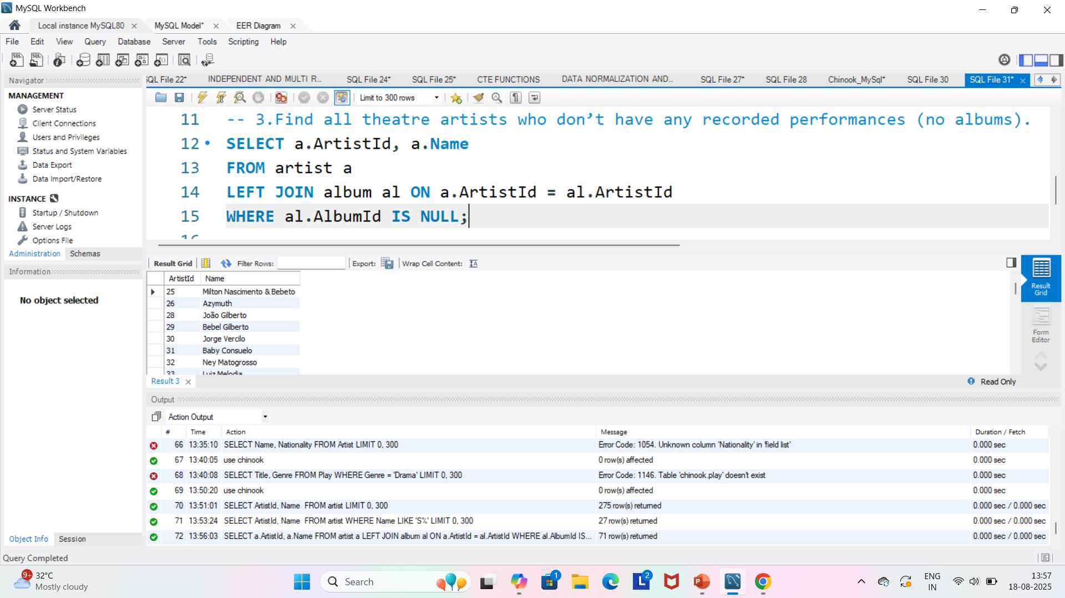
FIND ARTISTS WITH NO PLAYS
By joining artist and album, then checking for NULL, we identify artists who don’t have any recorded plays.

Slide 7
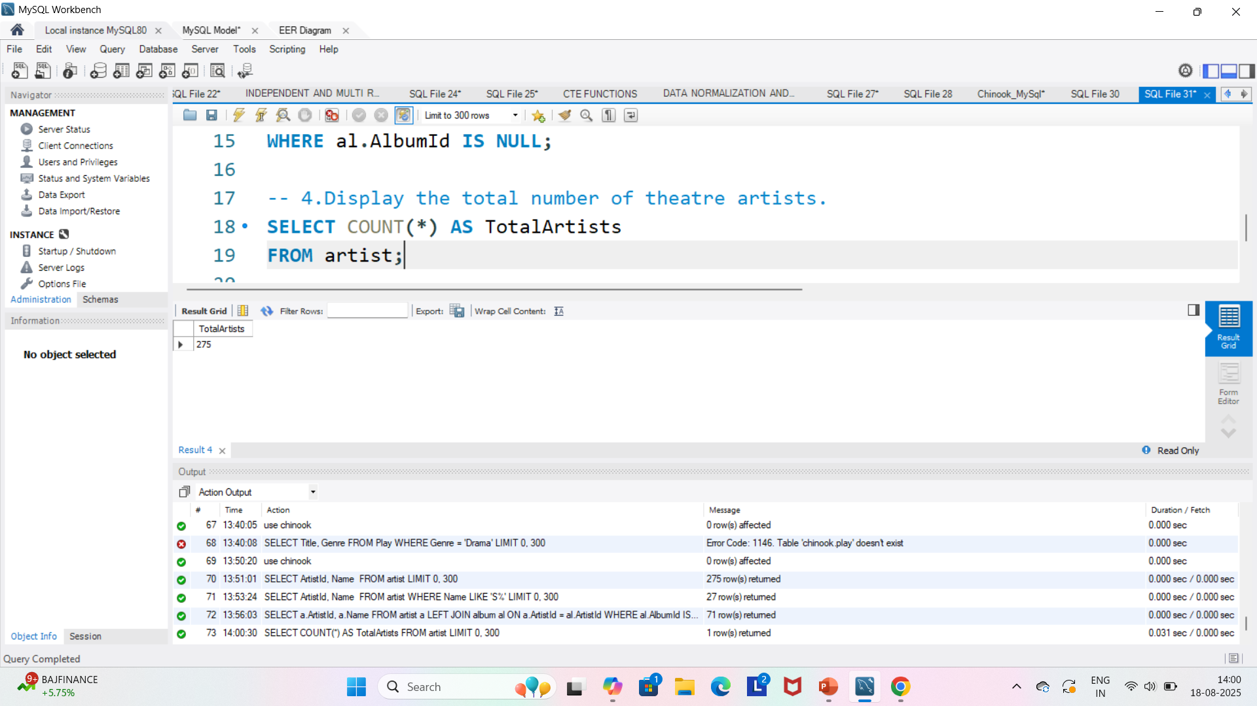
COUNT TOTAL THEATRE ARTISTS
The COUNT(*) function gives the total number of artists in the database.

Slide 8
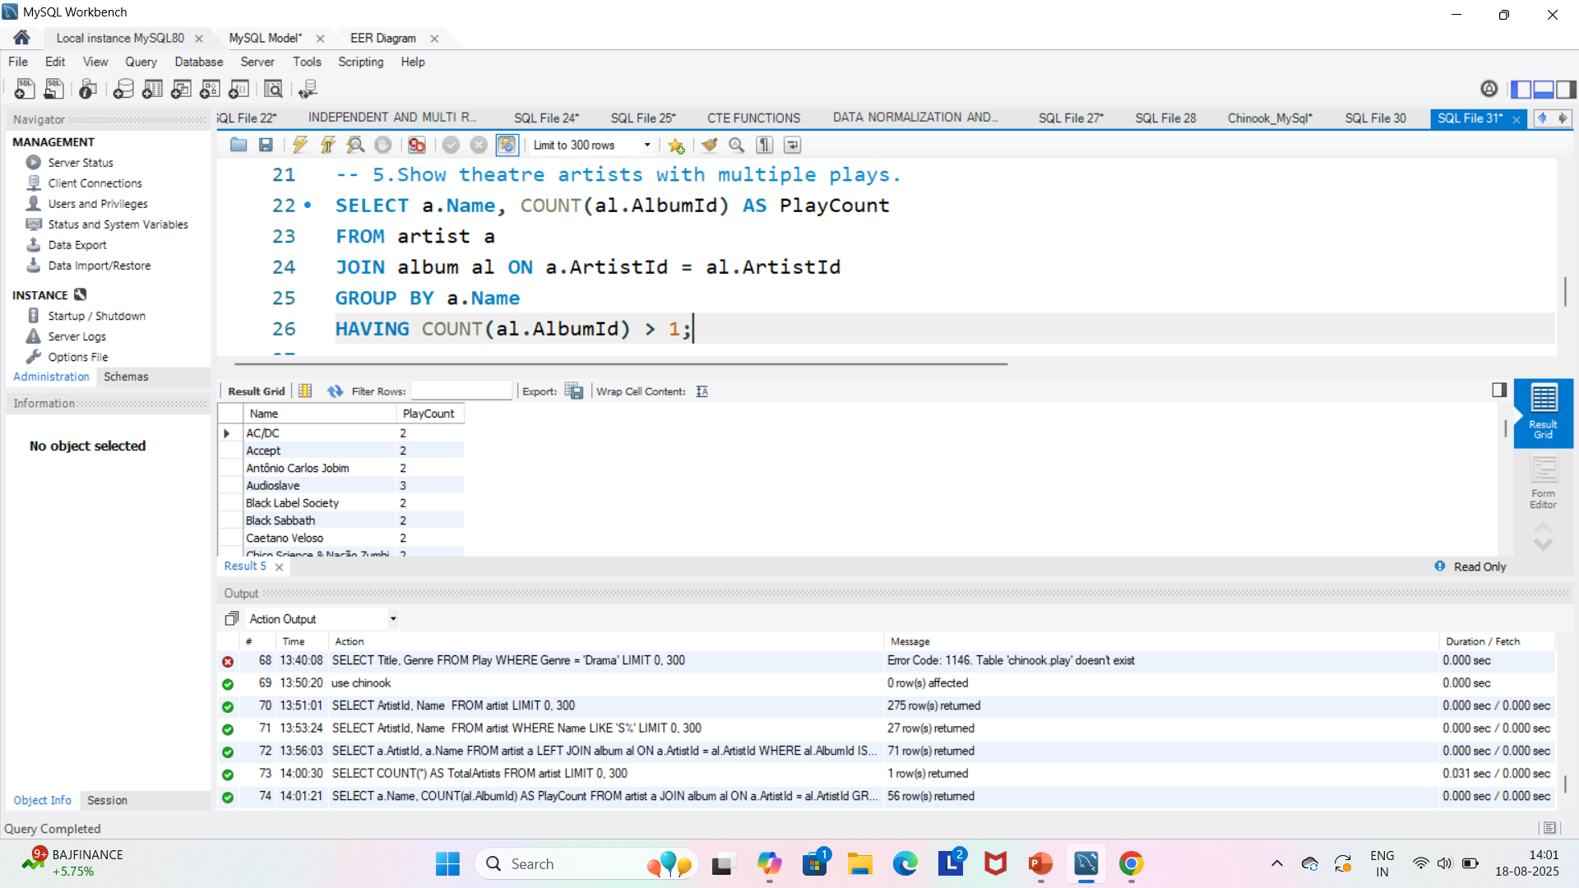
ARTISTS WITH MULTIPLE PLAYS
Using GROUP BY and HAVING, we find artists who acted in more than one play.

Slide 9
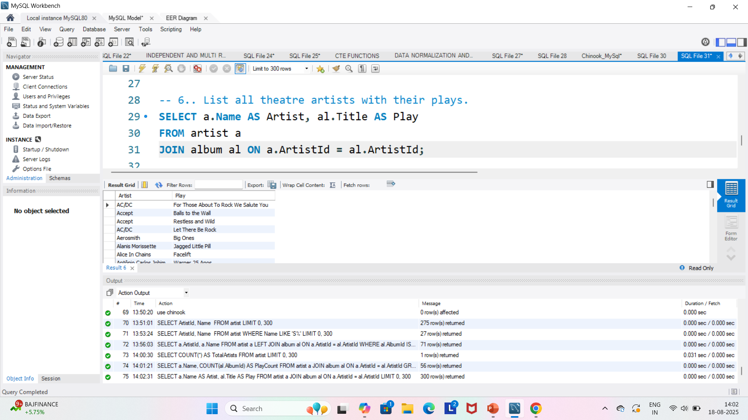
LIST ARTISTS WITH THEIR PLAYS
This query shows which plays (albums) belong to each artist by joining artist and album.

Slide 10
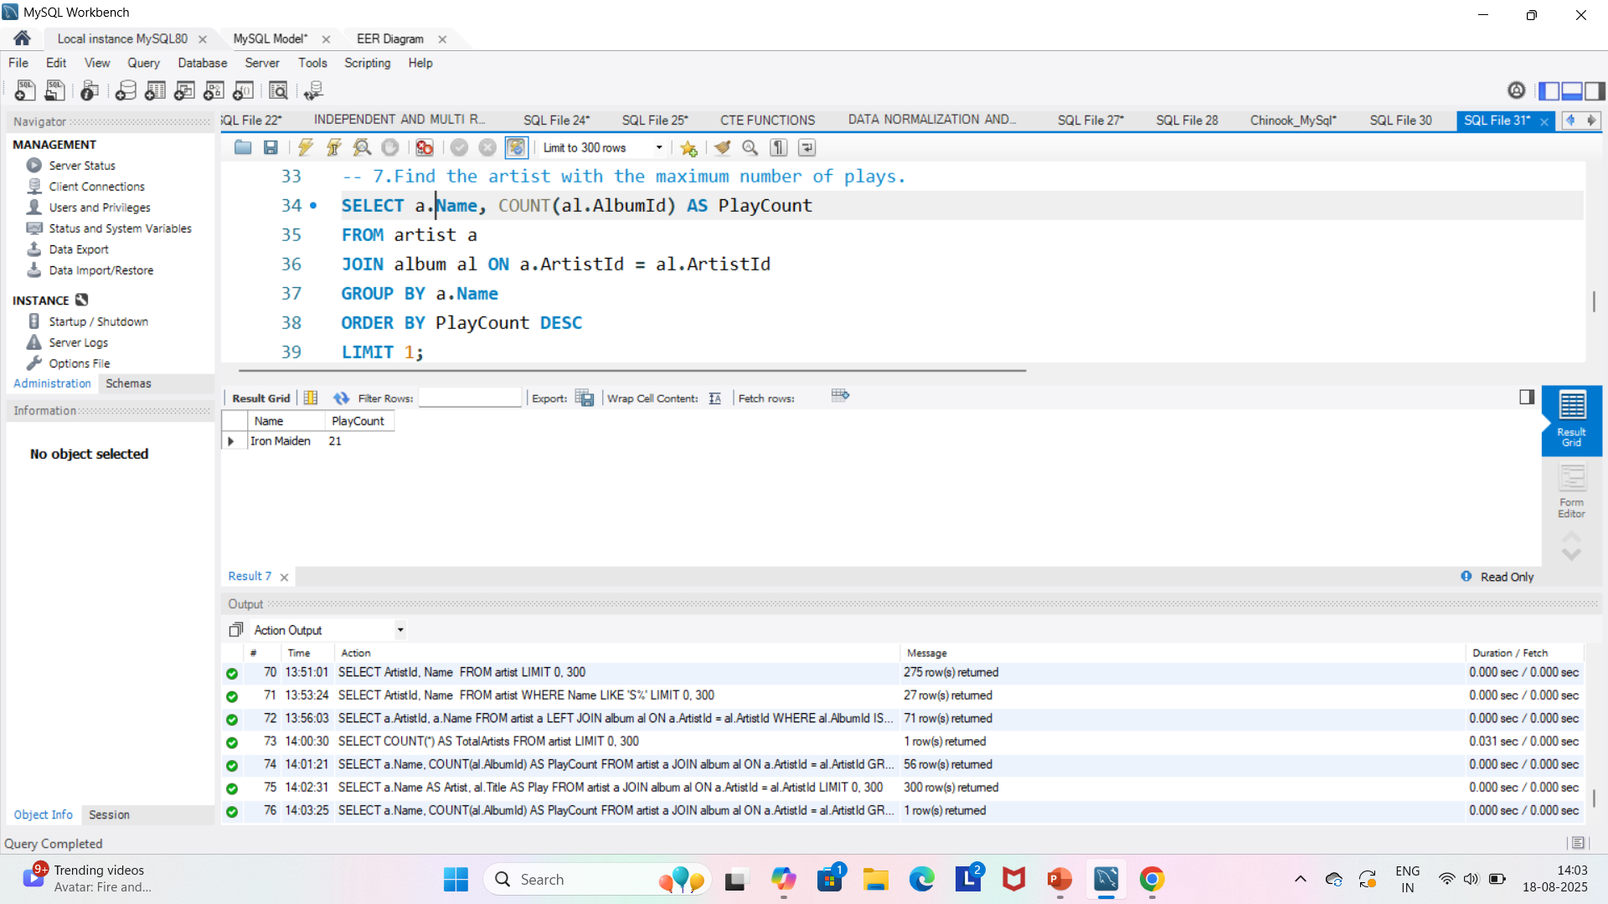
ARTISTS WITH MAXIMUM plays
We count the plays per artist and sort in descending order to pick the top artist.

Slide 11
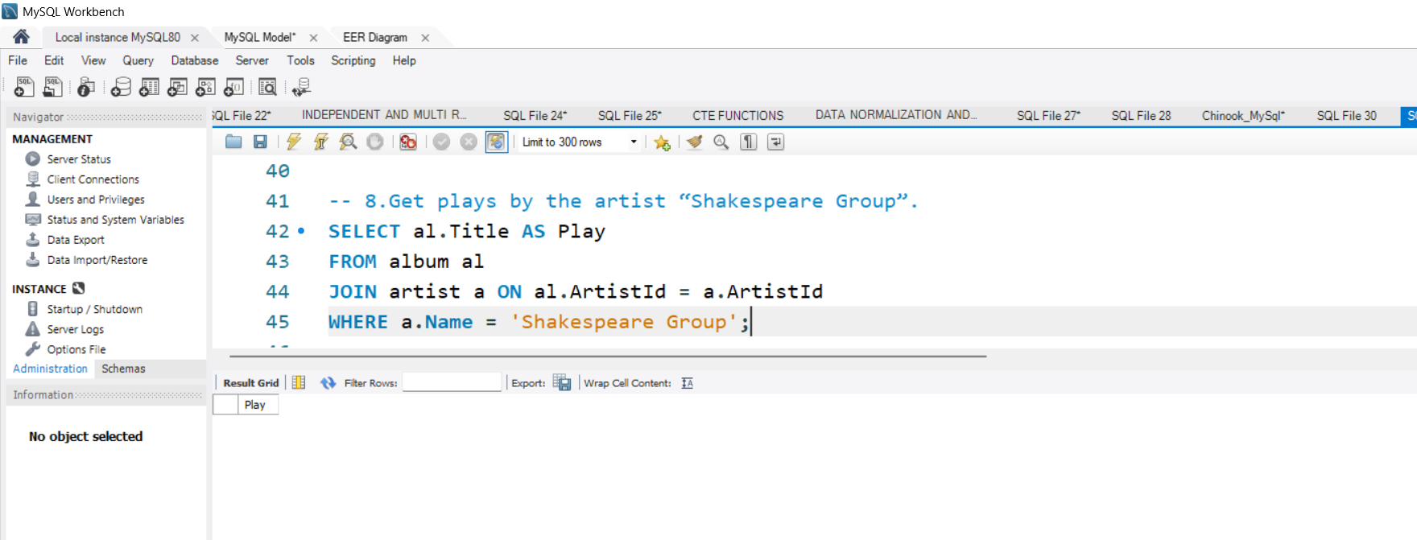
Plays by “Shakespeare group”
This query retrieves all plays linked to the artist named “Shakespeare Group.”

Slide 12
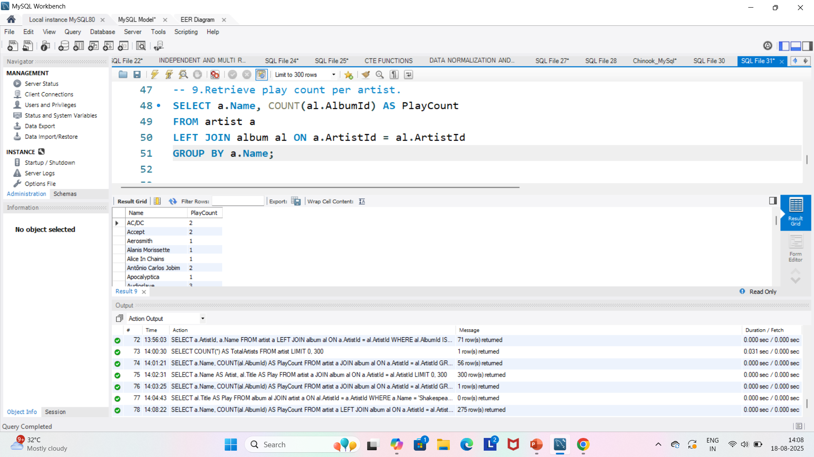
Play count per artists
Shows how many plays each artist has, using GROUP BY.

Slide 13
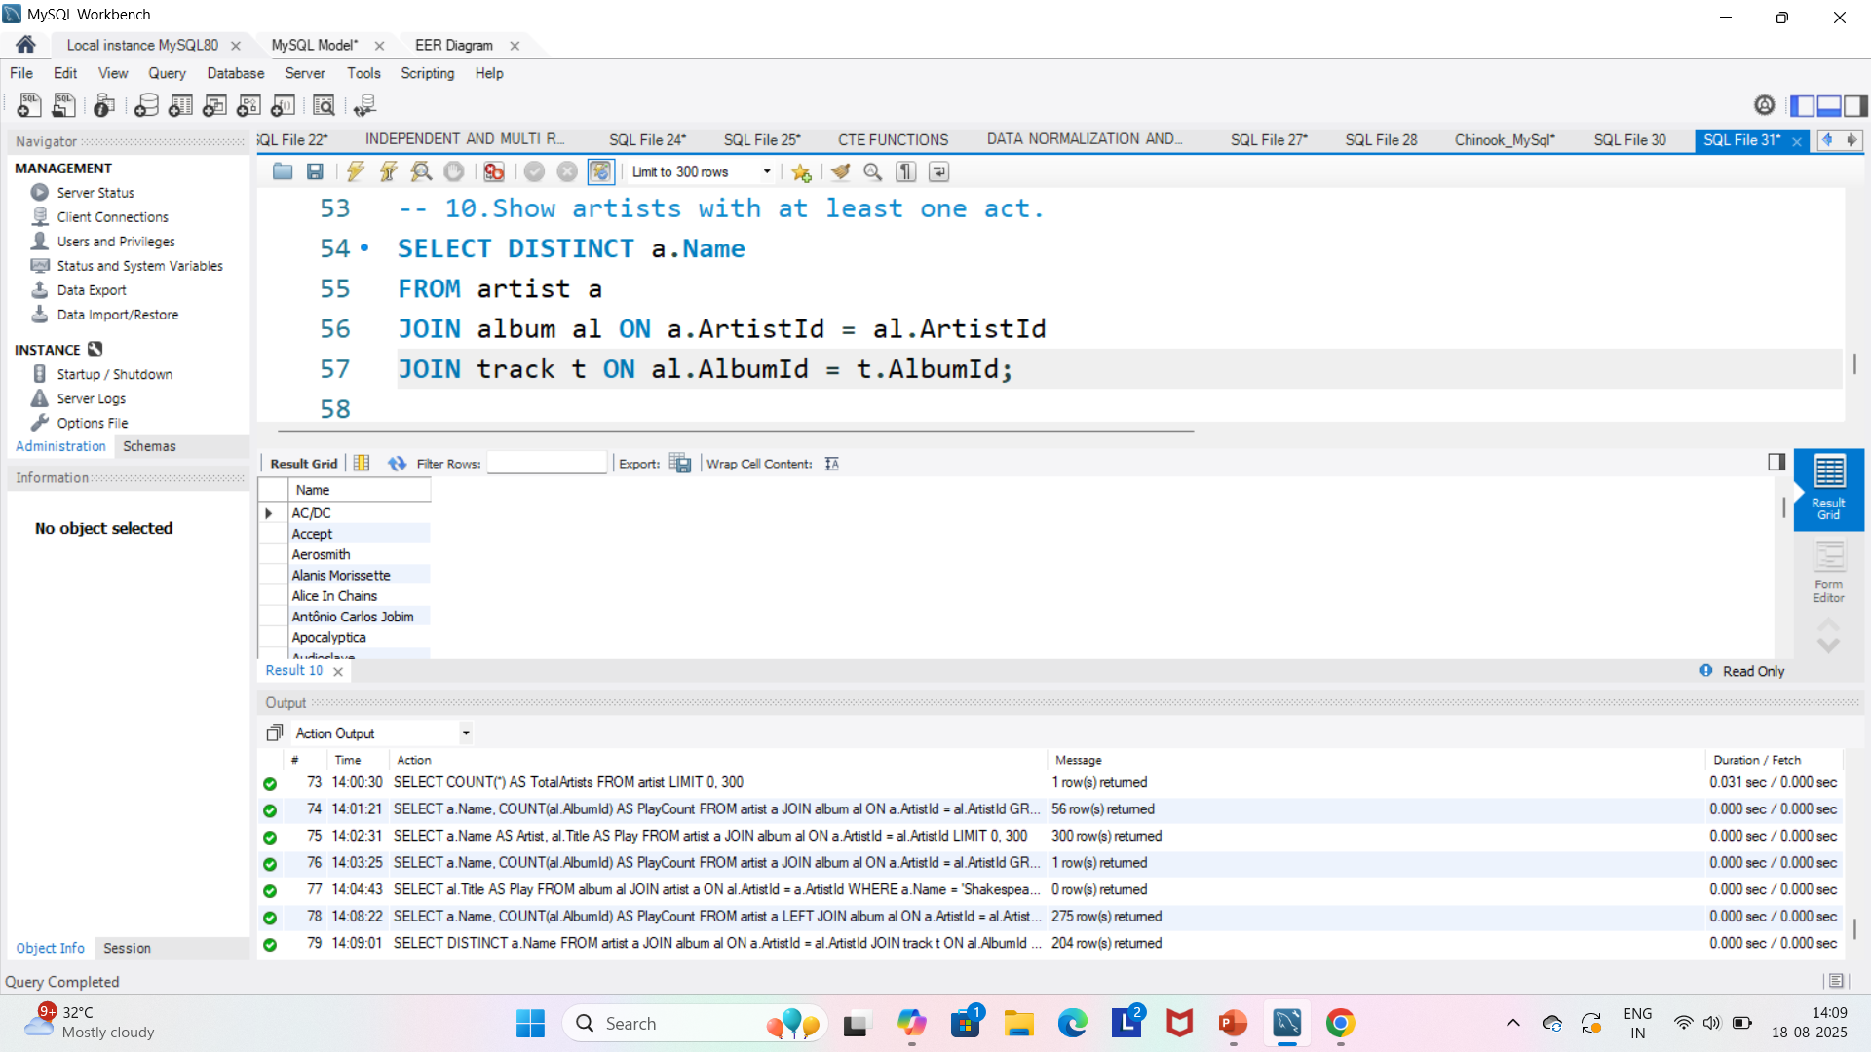
ARTISTS WITH ATLEAST ONE ACT
If an artist has a linked track, it means they performed in at least one act/scene.

Slide 14
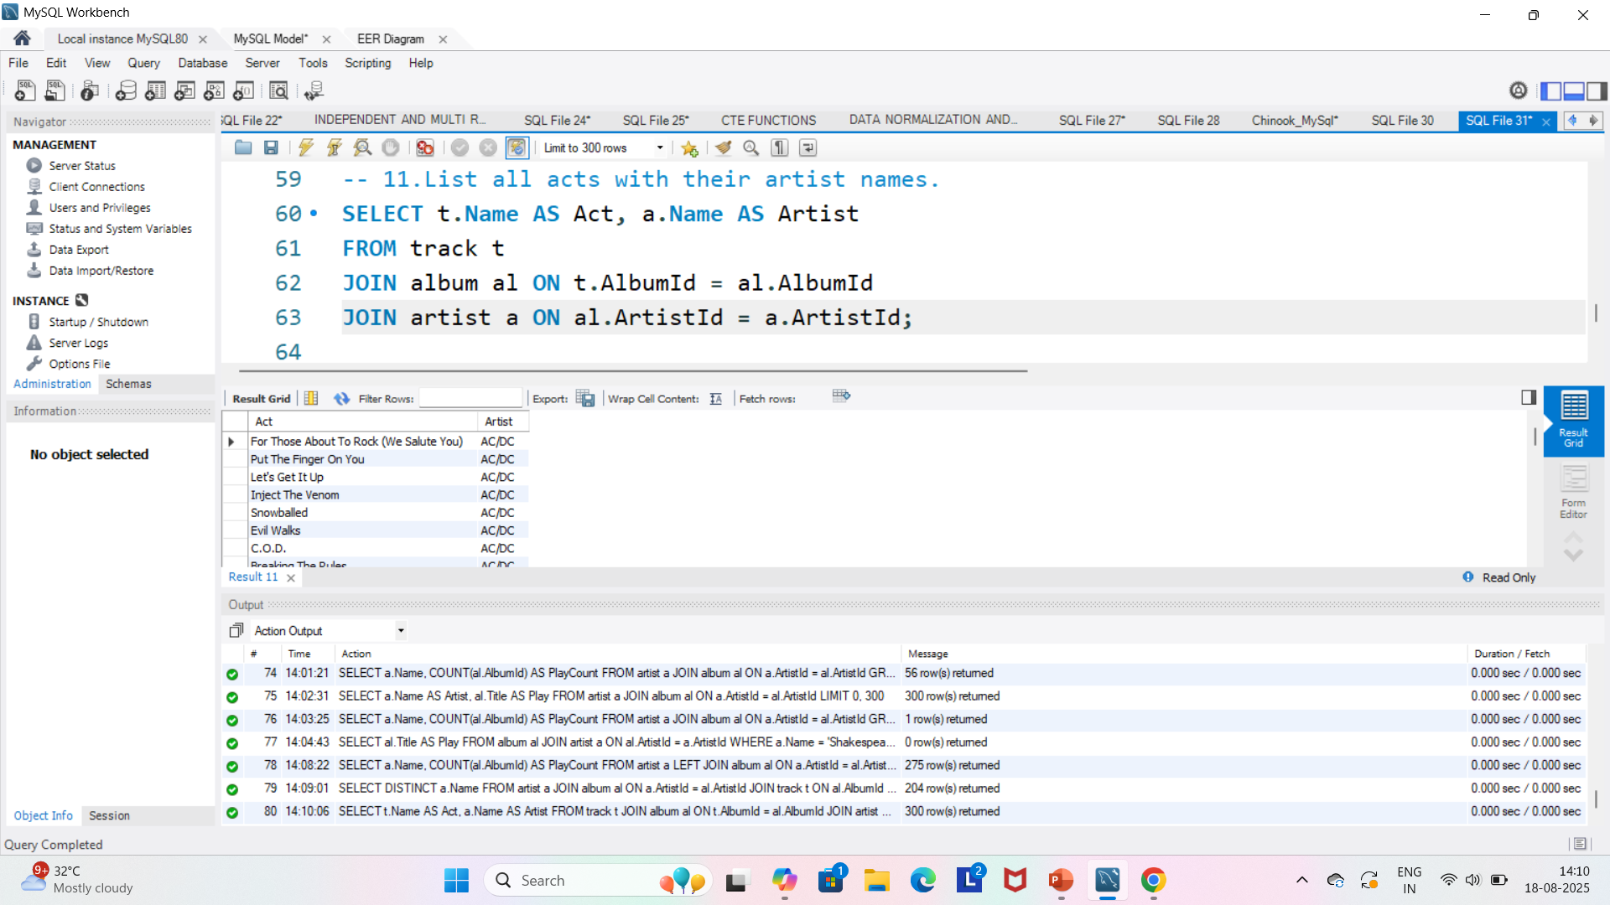
LIST ACTS WITH ARTISTS NAMES
We join track → album → artist to show which act belongs to which artist.

Slide 15
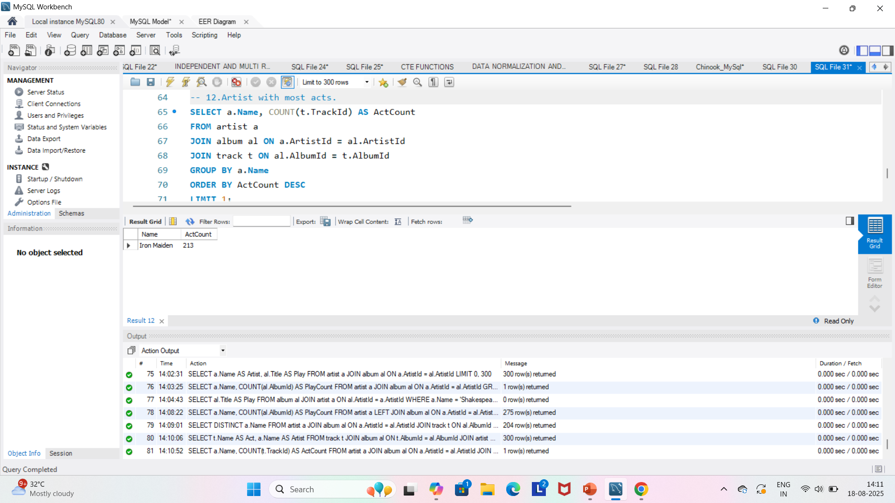
ARTISTS WITH MOST ACTS
We count all acts per artist, then select the one with the highest count.

Slide 16
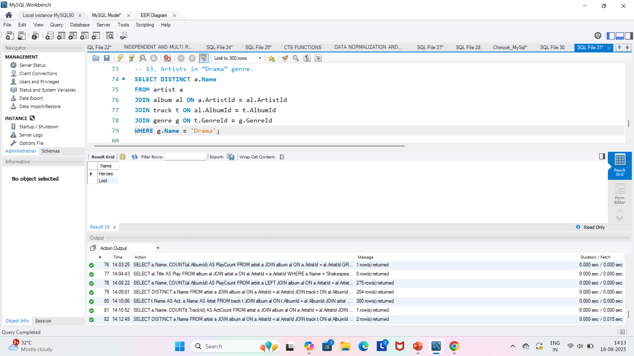
ARTISTS IN DRAMA GENRE
By joining with the genre table, we filter for artists who performed in the “Drama” genre.

Slide 17
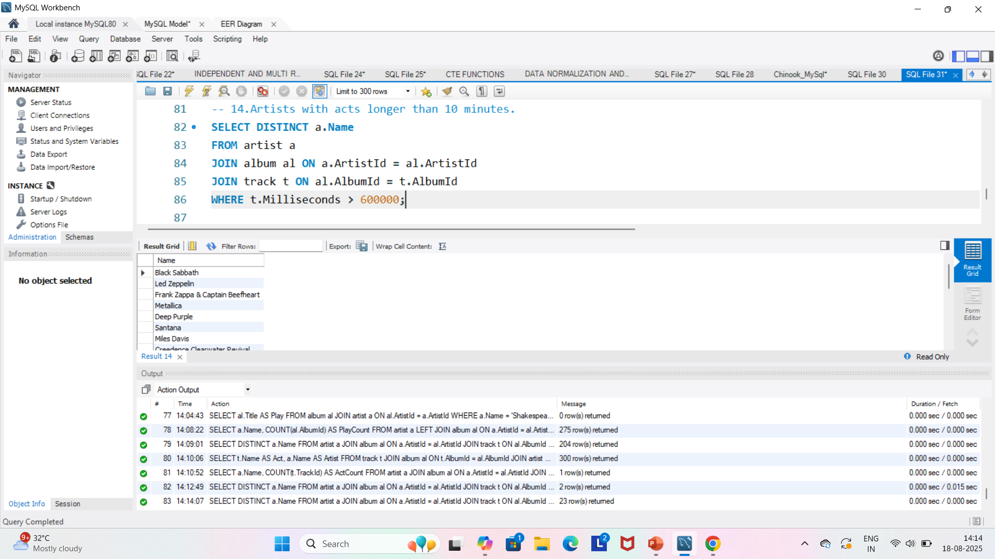
ARTISTS WITH ACTS LONGER THAN 10 MINUTES
We check if Milliseconds > 600000 (10 minutes) to find long acts.

Slide 18
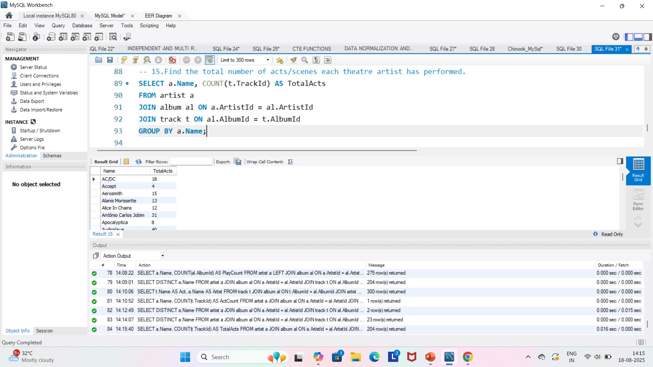
TOTAL ACTS PER ARTIST
We count the number of tracks (acts/scenes) linked to each artist.

Slide 19

ARTISTS IN PLAYLIST
If an artist’s act appears in playlist track, it means their work is included in a curated collection.

Slide 20
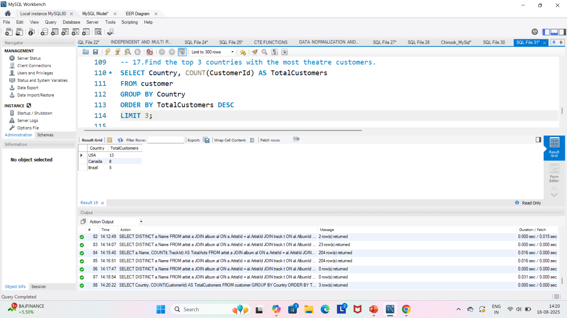
TOP 3 COUNTRIES WITH THE MOST THEATRE CUSTOMERS
This query groups customers by their country, counts how many are in each, and then shows the top 3 countries with the largest theatre audiences.

Slide 21
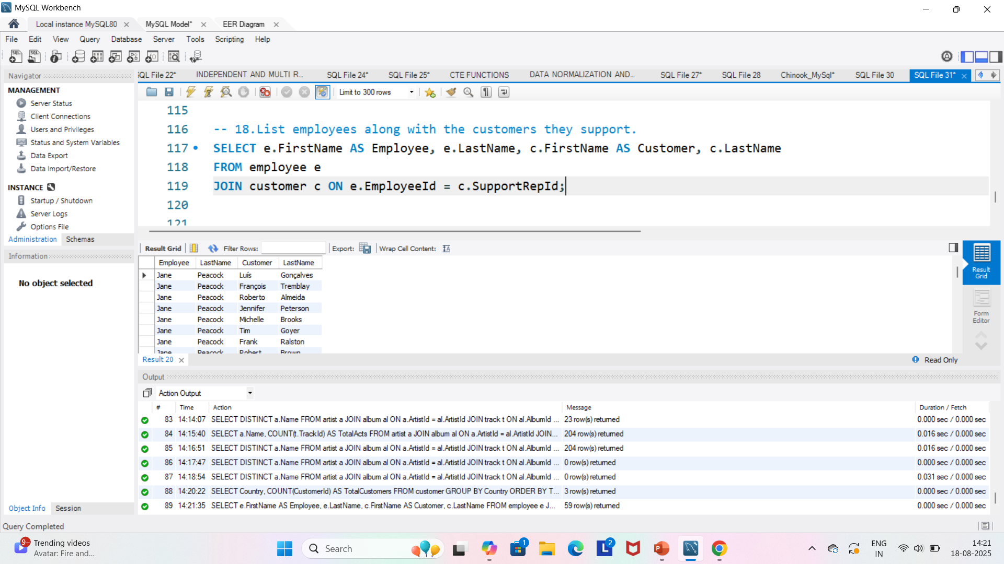
LIST EMPLOYEES ALONG WITH THE CUSTOMERS THEY SUPPORT
Each customer has a support representative (employee). This query joins the employee and customer tables to display which employee handles which customer.

Slide 22
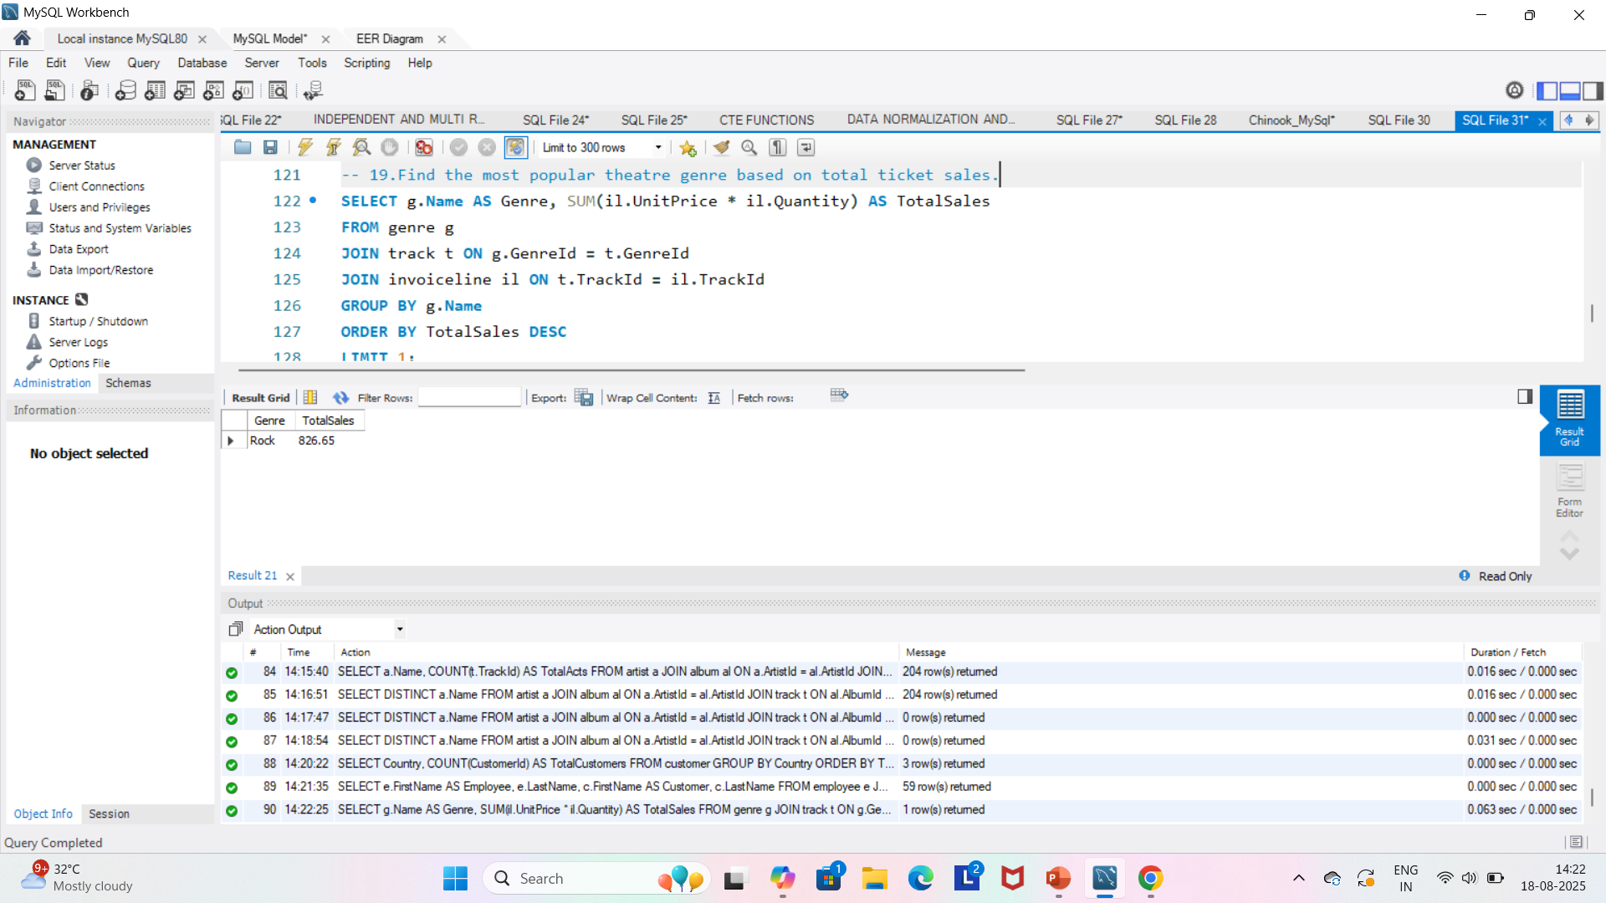
MOST POPULAR THEATRE GENRE BASED ON TOTAL TICKET SALES
This query calculates ticket revenue per genre (Drama, Comedy, etc.) by joining genre, track, and invoiceline. The genre with the highest sales is shown as the most popular.

Slide 23
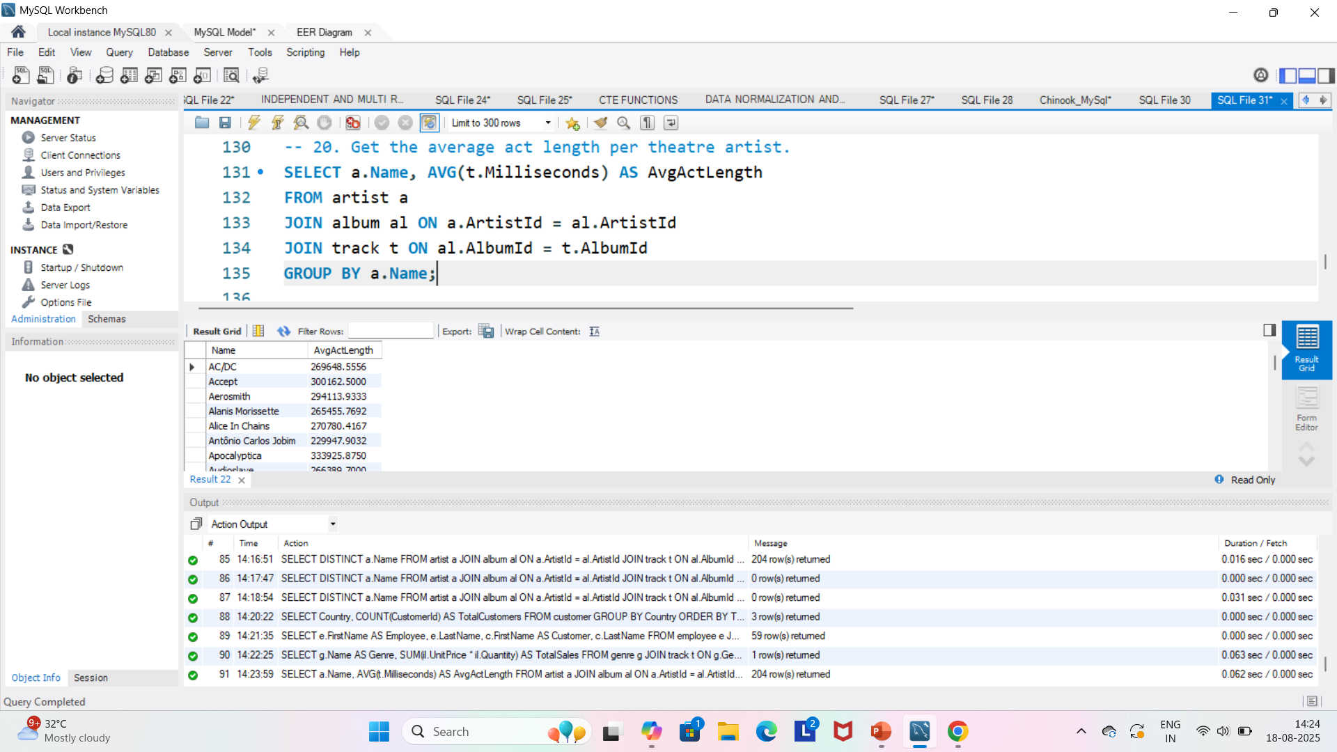
AVERAGE ACT LENGTH PER ARTIST
This uses AVG on milliseconds to find the average duration of an artist’s performances.

Slide 24


